Slide 1
Sales Data Analysis
ETL Project: Data Transformation and Analysis with Python, SQL, and MySQL

Slide 2
Objective :
The objective of this ETL project is to perform comprehensive sales analysis by extracting sales data from Kaggle, processing it using Python (Pandas) to handle missing values, correct formatting issues, and transform raw data into a structured format, and then loading it into a MySQL database for further analysis. The goal is to gain insights into key business metrics such as sales trends, product performance, regional sales distribution, and customer segment analysis. By analyzing the data, the project aims to identify high-performing product categories, track month-over-month and year-over-year sales growth, monitor profitability across regions, and forecast potential stockouts for top-selling products. This analysis helps inform data-driven business decisions, optimize inventory management, and guide marketing strategies.

Slide 3
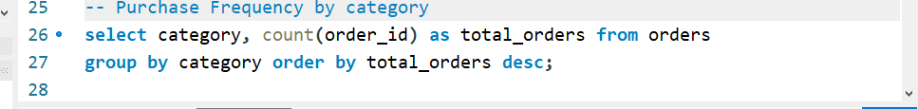
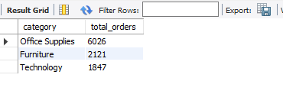
Purchase Frequency by category
Key Insight: The most frequently purchased category is "Office Supplies" with 6026 orders, followed by "Furniture" with 2121 orders and "Technology" with 1847 orders, indicating a higher demand for office supplies.

Slide 4
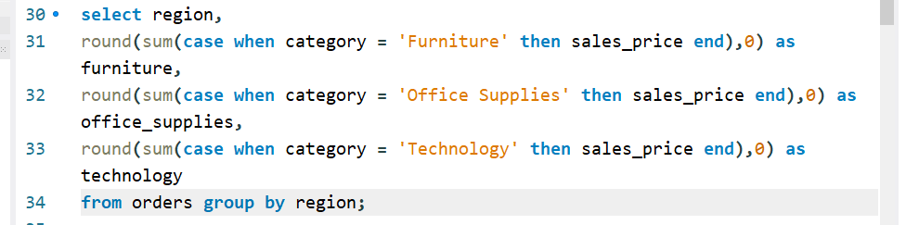
Display total sales of each category in each region

Slide 5
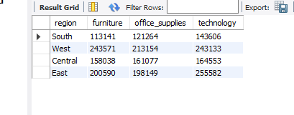
Key Insight: The "Technology" category generates the highest sales across all regions, with the East region leading at 255,582, followed by the West region at 243,133. The "Office Supplies" category performs strongest in the West region (213,154), while "Furniture" sales are highest in the West (243,571).

Slide 6
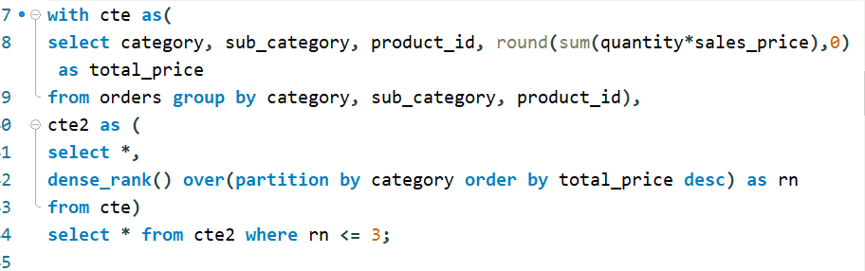
Top 3 best selling products in Each Category

Slide 7
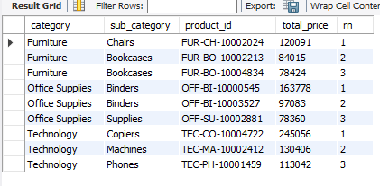
Key Insight: In the "Furniture" category, the top-selling product is "Chairs" with total sales of 120,091, followed by "Bookcases" in two variations. In "Office Supplies," "Binders" lead the sales with the highest sales at 163,778. For the "Technology" category, "Copiers" dominate the sales with 245,056, followed by "Machines" and "Phones." By identifying top-selling products in each category, businesses can optimize inventory levels, ensure better stock availability, and refine marketing strategies to promote these high-demand products.

Slide 8
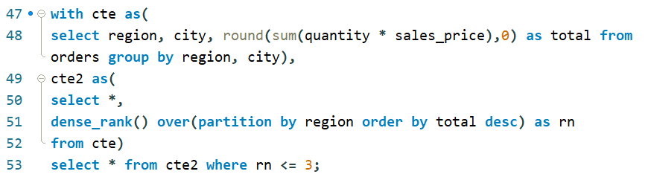
Top 3 Cities by Sales in Each Region

Slide 9
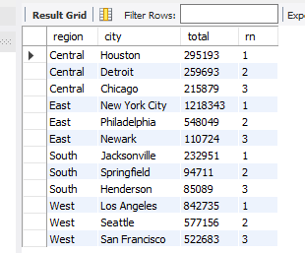
Key Insight: Houston leads sales in the "Central" region with 295,193, while New York City tops the "East" region with 1,218,343. Jacksonville leads the "South" with 232,951, and Los Angeles dominates the "West" with 842,735. Identifying these top-performing cities allows businesses to focus their marketing efforts and resources on high-revenue cities.

Slide 10
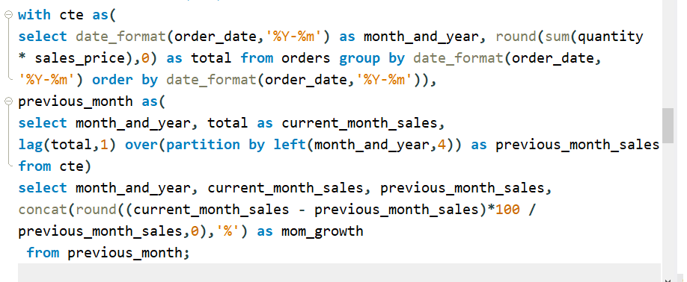
Month-over-Month (MoM) Sales Growth

Slide 11
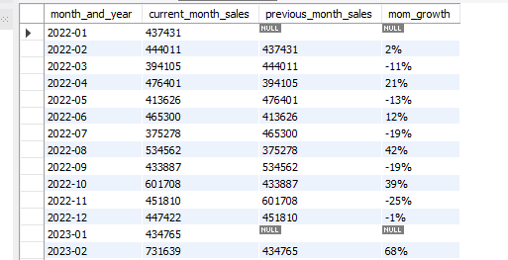
Key Insight: The Month-over-Month (MoM) sales growth shows fluctuating performance, with notable spikes such as a 42% growth in August 2022 and a 68% growth in February 2023. There were also significant declines, like the -46% drop in March 2023 and -47% in November 2023. Analyzing MoM growth helps businesses identify patterns, adjust strategies for months of low growth, and capitalize on high-growth periods for better planning and resource allocation.

Slide 12
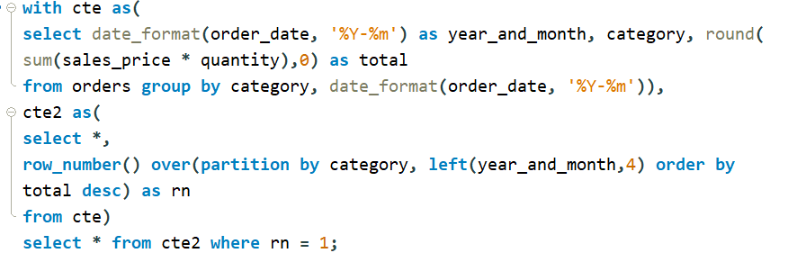
For each product category, find the month with the highest total sales;

Slide 13
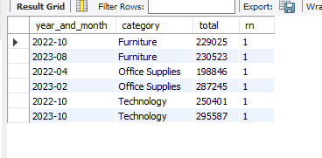
Key Insight: For "Furniture," the highest sales were in October 2022 (229,025) and August 2023 (230,523). "Office Supplies" saw the peak in April 2022 (198,846) and February 2023 (287,245). The "Technology" category reached its highest sales in October 2022 (250,401) and October 2023 (295,587). Identifying months with peak sales can help businesses plan promotional activities, seasonal campaigns, and inventory management to optimize sales performance during high-demand periods.

Slide 14
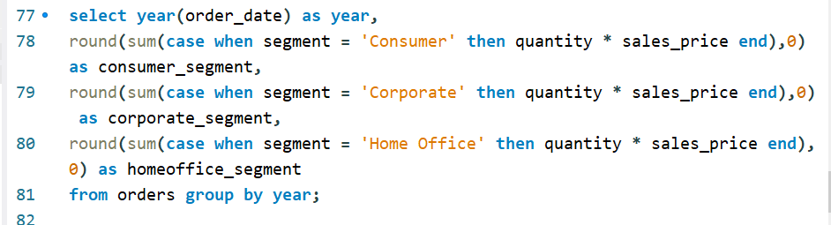
Total sales by each segment for each year

Slide 15

Key Insight: In 2023, the "Consumer" segment led with sales of 2,866,182, followed by "Corporate" with 1,712,303 and "Home Office" with 1,025,302. In 2022, the "Consumer" segment also led with 2,741,678, with "Corporate" at 1,682,613 and "Home Office" at 1,051,250. Analyzing total sales by segment across years helps businesses identify key revenue-driving segments and focus their marketing, sales, and product strategies accordingly.

Slide 16
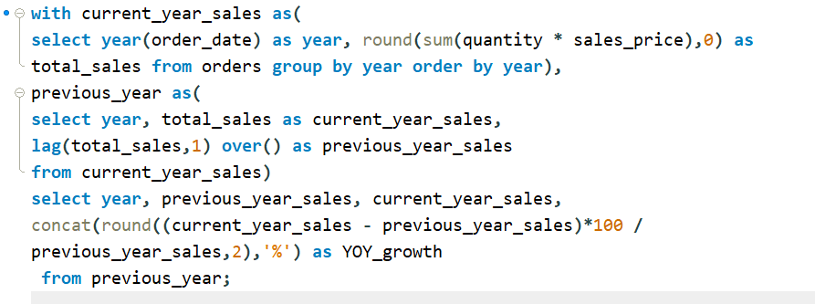
Year-over-Year (YoY) Sales Growth

Slide 17
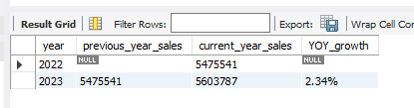
Key Insight: Sales grew from 5,475,541 in 2022 to 5,603,787 in 2023, reflecting a YoY growth of 2.34%. Tracking YoY sales growth helps businesses evaluate overall performance, identify trends, and make data-driven decisions for future strategies, such as adjusting marketing efforts, optimizing inventory, or exploring new revenue opportunities.

Slide 18
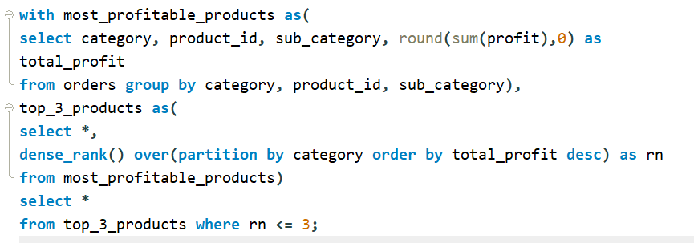
Top 3 Most Profitable Product in Each Category

Slide 19
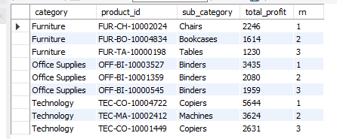
Key Insight: In the "Furniture" category, the most profitable products are "Chairs" with a profit of 2,246, followed by "Bookcases" and "Tables." In "Office Supplies," "Binders" lead the profit, with the highest profit coming from the product "OFF-BI-10003527" at 3,435. For the "Technology" category, "Copiers" dominate the profit, reaching 5,644, followed by "Machines." Identifying the top 3 most profitable products in each category helps businesses focus on high-margin items, optimize pricing strategies, and ensure effective resource allocation for better profitability.

Slide 20
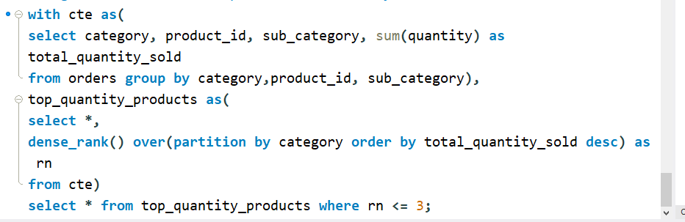
Identify the top 3 products with the highest quantity sold across all categories.

Slide 21
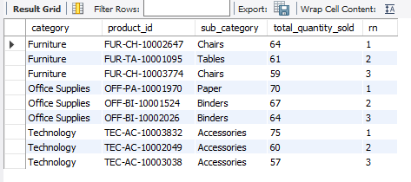
Key Insight: The highest-selling products across all categories include Accessories (TEC-AC-10003832) in the Technology category with 75 units sold, Paper (OFF-PA-10001970) in Office Supplies with 70 units sold, and Chairs (FUR-CH-10002647) in Furniture with 64 units sold. These products demonstrate consistently high demand, making it essential to closely monitor their stock levels to prevent shortages. Maintaining adequate inventory will help sustain sales, meet customer expectations, and optimize supply chain efficiency.

Slide 22
Thank You

